Slide 1
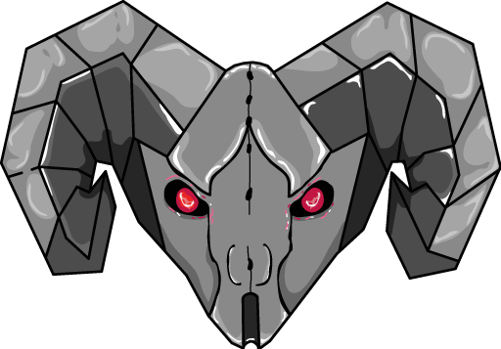
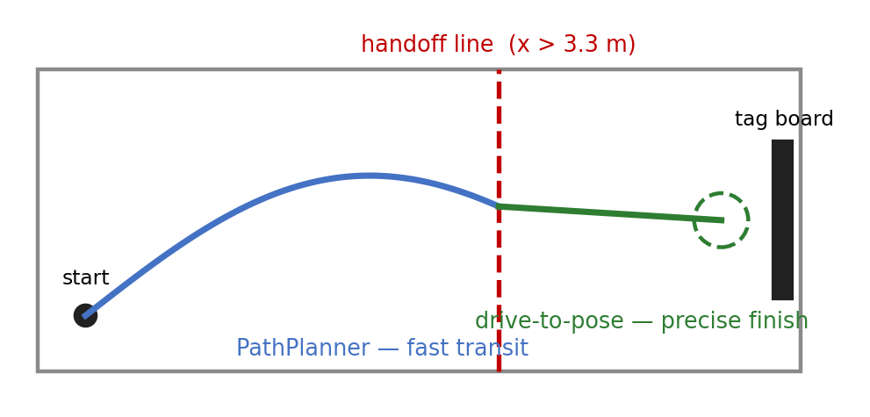
Team 999
MechaRAMS
Robot Localization & Precision Driving
The algorithms we are testing for 2027 — and what we learned in 2026
For students and mentors · Summer 2026

Slide 2
Agenda
Team 999
MechaRAMS
1
Where am I?
Localization: odometry, AprilTags, multi-tag, single-tag PnP vs TrigSolve, trust models
2
How do I drive there?
Trajectory: path following, drive-to-pose, and the handoff between them
3
2026 → 2027
What we ran last season, what hurt us, and what changes
4
How we decide
A/B testing, one competition configuration, what the same data tells us for free
2

Slide 3
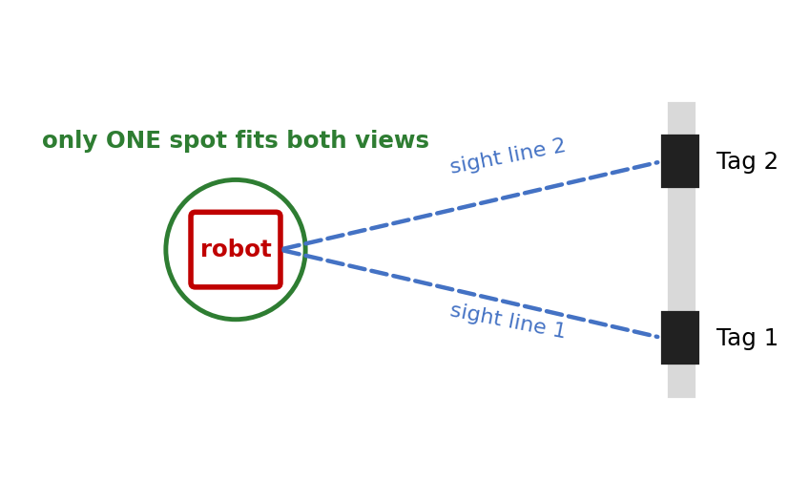
Our robot constantly answers two questions
Team 999
MechaRAMS
1. “Where am I?”
2. “How do I drive there?”
Localization — combine wheel counting, a gyro, and camera views of AprilTags into one continuous position estimate.
Trajectory — cover distance quickly, then arrive at an exact spot. Two different jobs, two different tools.
3

Slide 4
Part 1
“Where am I?”
Localization — from wheel counts and street signs to one trusted position
4

Slide 5

AprilTags — street signs with known addresses
Team 999
MechaRAMS
Each tag is a black-and-white square whose exact position on the field is published before the season — a street sign with a known address.
A camera reads the sign and works backwards: “if that sign looks like THAT from here, I must be standing HERE.”
Everything in Part 1 is about how well we do that “working backwards” — especially when the view is bad.
EXAMPLE
You see the “Main St / 5th Ave” sign at a 45° angle, half a block away. You instantly know roughly where you stand. The robot does the same — 50 times per second.
Why cameras at all? Because wheels lie (next slide).
a 36h11 AprilTag (what our cameras look for)
5

Slide 6
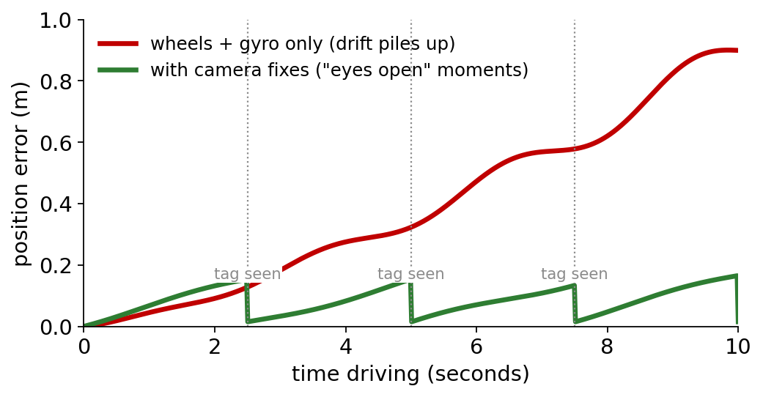
Algorithm 1 — Wheel odometry + gyro
Team 999
MechaRAMS
PROBLEM IT SOLVES
Gives a smooth position estimate 250× per second, always available — cameras cannot do that (30–50 fps, and tags are not always visible).
Counts wheel rotations + uses the gyro (an electronic inner ear).
Like crossing a room with your eyes closed, counting steps: smooth, but every wheel slip is a miscounted step.
Errors pile up → it drifts. It is the base layer, never the whole answer.
EXAMPLE
After 10 s of driving, wheels-only can be off by tens of cm. Each camera fix snaps the error back down — “opening your eyes” for a moment.
Always ON — every configuration we test keeps this as the base layer.
6

Slide 7
Algorithm 2 — Multi-tag solve
Team 999
MechaRAMS
PROBLEM IT SOLVES
Pins down position AND direction almost perfectly whenever one camera sees two (or more) tags in the same picture.
Two landmarks in one view → only one spot on the field fits both.
This is the only measurement whose DIRECTION we trust — it also keeps the gyro honest.
Not part of the A/B contest: every configuration uses it whenever 2 tags are visible.
EXAMPLE
Seeing both the corner drugstore AND the church tower — there is exactly one street corner where both look like that.
The real question: what do we do when only ONE tag is visible?
7

Slide 8
The single-tag problem — where the real contest is
Team 999
MechaRAMS
One tag in view happens a lot: during turns, at sharp angles, at the edge of the camera image, far away.
Our curved test path was designed to create exactly these moments (a 25° rotation sweep mid-path).
Algorithms 3 and 4 are two competing answers to the same question: what is a single tag worth?
Algorithm 3 — Single-tag PnP
Algorithm 4 — TrigSolve
The baseline. Guess the tag's tilt from the picture, work backwards to the robot. Vulnerable to the “mirror problem.”
The challenger. Skip the tilt guess entirely — use the direction we already know from the gyro. New for 2027, under test.
8

Slide 9
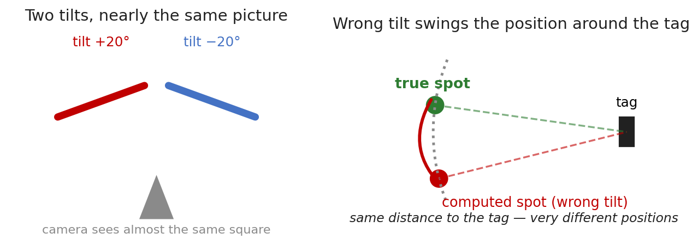
Algorithm 3 — Single-tag PnP (baseline)
Team 999
MechaRAMS
PROBLEM IT SOLVES
Gets a full position from just ONE tag — no help from any other sensor. Works even if the gyro is wrong.
Looks at how the tag's square shape is distorted in the picture → guesses the tag's position AND tilt → works backwards.
Weakness: judging the tilt of a flat square from far away is genuinely hard.
A poster angled 20° left vs 20° right looks almost identical across a room — the computer has the same problem (“ambiguity”).
Today we protect ourselves with an “ambiguity gate” — throw away suspicious frames. A bandage, not a cure.
EXAMPLE
Robot approaches at an angle, sees one tag at 3 m. PnP sometimes picks the mirror-image tilt — and reports a position decimeters off.
9

Slide 10
Why a wrong tilt is so costly — the lever arm
Team 999
MechaRAMS
We never trust the direction PnP reports (2026 lesson). But the tilt guess still participates in computing the POSITION.
A wrong tilt swings the computed position around the tag like a lever arm.
The farther the tag, the longer the lever — small tilt error, big position error.
A LITTLE MATH
position error ≈ tilt error (radians) × distance
A few degrees of tilt noise at 2 m → several cm of error.
A full mirror flip → decimeters, in one frame.
The error is bimodal: usually fine, occasionally terrible. Competition cares about the occasional terrible frame.
10

Slide 11
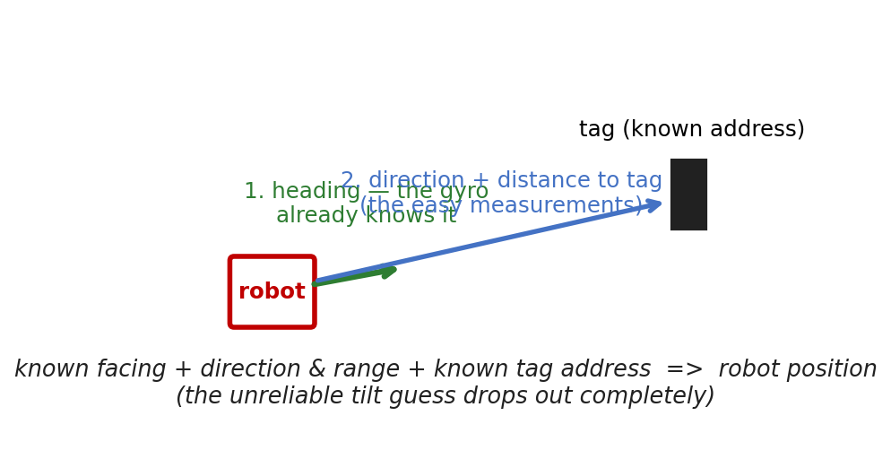
Algorithm 4 — Single-tag TrigSolve (challenger)
Team 999
MechaRAMS
PROBLEM IT SOLVES
Removes the unreliable tilt guess from single-tag frames. The mirror problem physically cannot affect it — error becomes small and smooth instead of occasionally huge.
Key insight: the robot already knows which way it is facing (gyro, kept honest by multi-tag frames).
Uses only the EASY camera measurements: direction to the tag (very precise) and distance (decent).
Known facing + direction & range + tag's known address → position.
EXAMPLE
“The sign is 2 m ahead-and-a-bit-left, and I know I’m facing the board → I must be standing HERE.”
Idea from FRC 6328; now built into PhotonVision; team 1678 raced it all season. We test it against PnP.
11

Slide 12
PnP vs TrigSolve — they fail in OPPOSITE ways
Team 999
MechaRAMS
 | Single-tag PnP | TrigSolve
Mirror problem (ambiguity) | VULNERABLE — decimeter jumps | IMMUNE — tilt drops out
Gyro / heading drift | IMMUNE — uses no gyro | VULNERABLE — inherits gyro error
Error character | Bimodal: fine or terrible | Smooth: grows gently with heading error
Best case | Close range, head-on views, or a broken gyro | Far / angled views, turns — the common case
A LITTLE MATH: TrigSolve error ≈ heading error × distance ≈ 3.5 cm per degree at 2 m. Our gyro stays within ~0.5° when multi-tag frames keep correcting it → ≤ ~2 cm. That is why opposite failure modes matter: we A/B them with data instead of arguing.
12

Slide 13
How it all merges — the estimator
Team 999
MechaRAMS
All measurements flow into one running weighted average (a Kalman filter) — like averaging opinions, but listening more to the friend who is usually right.
Every camera measurement carries a trust weight. Bad frames are rejected before they ever enter (impossible positions, too far, too ambiguous).
Odometry + gyro
250× / second
ESTIMATOR
weighted average
One trusted pose
for aiming & driving
Camera fixes
30–50 / second, gated
Every frame is matched to where the robot was when the photo was taken (timestamping) — at 2 m/s a 50–100 ms-old picture is 10–20 cm of travel. Non-negotiable plumbing in every configuration.
13

Slide 14
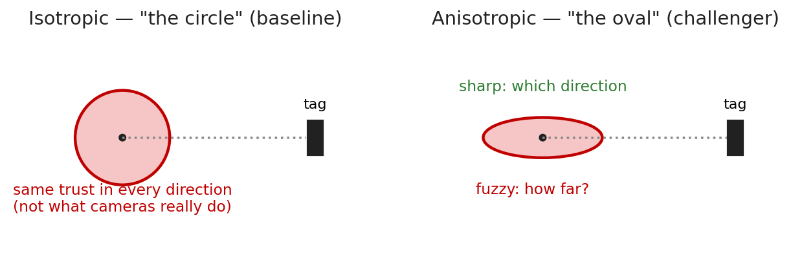
Algorithms 5 & 6 — how much to trust a camera fix
Team 999
MechaRAMS
PROBLEM IT SOLVES
States the confidence of each camera measurement so the estimator listens the right amount — in the right DIRECTIONS.
Headlights at night: you know the car’s DIRECTION precisely, but its DISTANCE only roughly. Cameras are the same about tags.
So real uncertainty is an OVAL pointing at the tag — fuzzy along the line to it, sharp across it.
Algorithm 5 (circle, baseline): same trust in every direction. Simple, validated — but over-trusts the fuzzy distance.
Algorithm 6 (oval, challenger): tells the truth about the shape.
Honest caveat: the oval’s real size must be MEASURED on the robot first (test step 15). Until then it runs with placeholder numbers.
EXAMPLE
With the circle, the robot’s belief “breathes” toward/away from the board with each frame — our prime suspect for the 8 cm of drift AFTER the robot stopped (July 1 test).
14

Slide 15
Part 2
“How do I drive there?”
Trajectory — fast transit, precise arrival, and when to switch
15

Slide 16
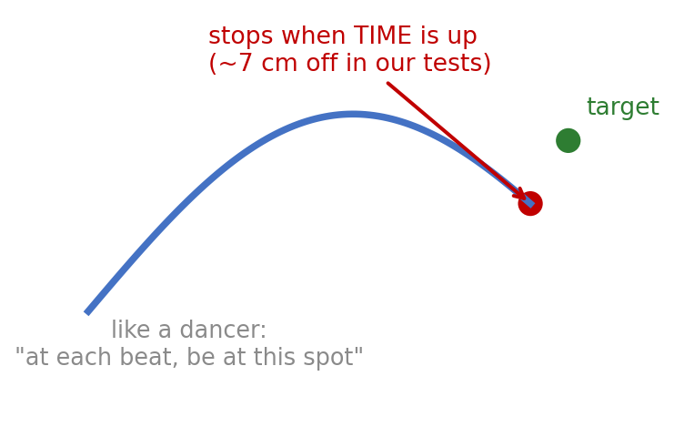
Algorithm 7 — Path following (PathPlanner)
Team 999
MechaRAMS
PROBLEM IT SOLVES
Covers distance FAST and smoothly along a pre-planned route, respecting what the drivetrain can physically do.
Like a dancer performing a memorized routine to music: at each beat, be at this spot.
The catch: it ends when the MUSIC ends — not when you are on your mark.
Our tests: stops ~7 cm from the true target. Fine mid-field; not fine for scoring.
EXAMPLE
The 2026 robot: PathPlanner computed “this path takes 2.0 s” and stopped at t = 2.0 s — wherever the robot actually was. Sometimes fine, sometimes not.
16

Slide 17
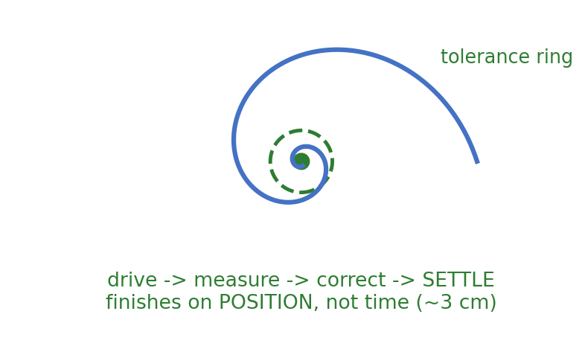
Algorithm 8 — Drive-to-pose (precision parking)
Team 999
MechaRAMS
PROBLEM IT SOLVES
GUARANTEES arrival: finishes only when the robot is actually AT the target — on position, never on the clock.
No route, no clock: drive → measure → correct → repeat.
“Settle” check: must STAY inside the tolerance for a moment — one lucky bounce through the target doesn’t count.
Safety timeout so it can never get stuck forever.
Our tests: ~3 cm. Slower — wrong tool for crossing the field.
EXAMPLE
Parallel parking: you don’t follow a script for 4.0 seconds and stop — you keep correcting until the car is IN the spot.
17

Slide 18
Algorithms 9 & 10 — combining them: the handoff
Team 999
MechaRAMS
PROBLEM IT SOLVES
Gets BOTH speed and precision: the dancer covers the field, the parker finishes the job. The two options differ only in WHEN to switch.
Alg 9 — Sequential: finish the whole routine, then park. Predictable, kept for debugging — but you wait for the music to end even when you’re already close.
Alg 10 — Spatial (our choice): the moment the robot crosses a line on the floor (x > 3.3 m), abandon the routine and start parking. Faster cycle, parker controls more of the approach.
18

Slide 19
Measured in simulation — July 2026
Team 999
MechaRAMS
Handoffs park 2–3× closer than path-following alone.
Spatial chosen: nearly sequential’s accuracy, faster cycle, no timeouts.
All numbers from replayable simulation logs — the robot-carpet re-run is test steps 16–19.
Decision made 2026-07-01: spatial handoff is the competition pattern; the others remain as debug / baseline tools.
19

Slide 20
Part 3
2026 → 2027
What we ran last season, what hurt us, and what changes
20

Slide 21
What we ran in 2026
Team 999
MechaRAMS
2 Limelight cameras (of the 4 we own) + QuestNav headset tracking.
CTRE’s built-in estimator; a state machine chose ONE “best” camera result per loop.
MegaTag2: the Limelight computed poses using the heading we sent it.
Hard gates: reject vision > 0.6–0.8 m from odometry; hard pose resets to re-anchor.
Turret auto-aim computed the hub angle from this fused pose.
It was a thoughtful design.
The MT1/MT2 selection, IMU management, and Quest fallback logic were more sophisticated than most teams’.
The losses were in HOW measurements were weighted and discarded — and in having no way to measure any of it.
Symptom we all remember: global position good enough to drive — but 2–3° of heading error was fatal for shooting, with no way to check it.
21

Slide 22
What actually hurt us — five findings
Team 999
MechaRAMS
1
Circular heading feedback — MegaTag2 poses are computed FROM the heading we send — then we fused its heading back in. The estimator “confirmed” its own guess; drift locked in.
2
One camera per loop — We picked one “best” camera and threw the other’s valid measurement away. More correct measurements always help — the filter does the weighting.
3
No logging / replay — No structured logs → every tuning argument was guesswork. This was the single biggest gap.
4
Mid-match pose resets — Re-anchoring snapped the pose while driving — visible as aim jumps, and one measurement was trusted completely.
5
Gates that lock in drift — “Reject vision > 0.6 m from odometry” — but when odometry itself drifted past the gate, every CORRECT camera fix got rejected.
22

Slide 23
The 2–3° problem, in numbers
Team 999
MechaRAMS
A LITTLE MATH
miss distance ≈ heading error (radians) × shot distance
3° × 5 m ≈ 26 cm off at the hub — the difference between scoring and bouncing out.
In 2026, the shot was aimed entirely from the fused global pose — heading error went straight into the shot, invisibly.
Findings 1–5 each nudged the heading or position a little; the shot paid for all of them at once.
The 2027 fixes attack every link: no circular heading (fix 1), more measurements (fix 2), logs to SEE the error (fix 3), no snaps (fix 4), physics-based rejection instead of hard gates (fix 5).
23

Slide 24
2026 → 2027 — what changes
Team 999
MechaRAMS
 | 2026 season | 2027 prototype
Cameras fused | One “best” per loop | Every valid measurement, every camera
Direction from single tag | Fused (circular feedback) | Never — direction only from multi-tag
Single-tag position | PnP only, gated | PnP vs TrigSolve — decided by A/B test
Trust model | Linear in distance, uncalibrated | distance² law; circle vs oval A/B, then fitted from logs
Bad-frame handling | Hard gates + mid-match resets | Physics-based rejection; resets only when stopped + quarantine
Driving finish | Path ends on the clock | Spatial handoff → drive-to-pose, ends on position
Measurement | None (dashboard only) | AdvantageKit logs — every frame replayable, every decision explainable
24

Slide 25
How we decide — test, don’t argue
Team 999
MechaRAMS
1
Simulation
2
Real robot
3
The verdict
Steps 1–12: straight + curved runs, reset test. Same start pose and target for every configuration — numbers compare 1:1.
Steps 13–19: camera calibration, a static accuracy grid, fitting the oval’s real size, then the same driving tests on carpet.
Adopt the configuration with the best WORST-CASE error over 5 runs — competition cares about your worst cycle, not your average.
Both contests (PnP vs TrigSolve, circle vs oval) run as A/B switches in the same code — same frames, fair fight, one variable at a time.
45/45 automated tests already guard the math before any run happens.
25

Slide 26
One robot, one configuration — but smart every frame
Team 999
MechaRAMS
The competition robot runs ONE fixed setup — no driver-switched vision modes. A mode nobody practiced with loses matches.
But the robot DOES switch algorithms — automatically, per camera frame, 50× a second:
Sees 2 tags
→ multi-tag solve (always wins)
Sees 1 tag
→ the A/B winner (PnP or TrigSolve)
No heading available for that frame
→ quiet fallback to PnP
Frame looks impossible
→ rejected, with the reason logged
The game situation picks the algorithm — faster and more reliably than any human could.
26

Slide 27
Bonus — the same logs answer camera placement
Team 999
MechaRAMS
Camera placement is really the question “what does each camera see, how often, and how well?” — and every test run records exactly that. No extra work.
Cross-eye angle (±18° today — a guess)
2 cameras or 4?
Is a mount bad?
The curved runs map when we drop to 1 or 0 visible tags mid-turn. The blind-moment map says whether to widen or narrow the cameras.
If blind moments happen mostly when the robot rotates away from the board — that is the data-driven trigger for the rear pair (code is already wired for them).
A camera consistently fuzzier than its twin at the same distance has a flexing mount or bad calibration — the error-vs-distance curves expose it immediately.
27

Slide 28
Cheat sheet — which algorithm wins when
Team 999
MechaRAMS
Situation | What wins
Both tags visible | Multi-tag solve — every configuration agrees
Single tag, angled or far view (common during approaches) | TrigSolve expected — the mirror problem can’t touch it
Curved / rotating trajectory | TrigSolve matters more — turning multiplies single-tag moments
High speed | Timestamping + spatial handoff; fewer clean frames again favors TrigSolve
Parked near the board (final alignment) | Anisotropic “oval” trust — once fitted from robot logs
After a collision / gyro glitch | Plain PnP is safer until a multi-tag view fixes the heading
This is why losing algorithms stay in the code as fallbacks instead of being deleted.
28

Slide 29
Vocabulary
Team 999
MechaRAMS
PnP (Perspective-n-Point) — the math answering “given how these known points look in my photo, where was the camera?”
Ambiguity — two mirror-image tilts of a flat tag that look nearly identical to the camera.
Odometry — tracking position by counting your own movements (wheels + gyro).
Covariance / std deviation — the “how sure am I?” number on a measurement; the merge listens more to smaller numbers.
Fusion / estimator — the running weighted average combining odometry with camera fixes.
Handoff — switching from the route-follower to the precision parker mid-drive.
Settle — requiring the robot to STAY on target briefly before declaring success.
29

Slide 30
Three things to remember
1. Layers, not one magic algorithm. Odometry always runs; cameras correct it; the contests are only about the weakest links (single tags, trust shape).
2. Arrive on position, not on the clock. Paths for transit, drive-to-pose for the finish — the spatial handoff gives us both.
3. Measure, don’t argue. 2026’s biggest gap wasn’t an algorithm — it was having no logs. Now every claim on these slides is testable, and the tests are already written.
Questions?
30

